Slide 1

Select Topics in Python
Random Library
Adwith Malpe

Slide 2
Agenda
Agenda
What is the Random Library?
Demo

Slide 3
What is the Random Library?
What is the Random Library?
Library that allows a programmer to obtain a random number in a given range, pick a random element from a list, etc.
Frequently used to generate random numbers
Also known as an in-built module of Python
Random module creates pseudorandom numbers which means they are not truly random

Slide 4
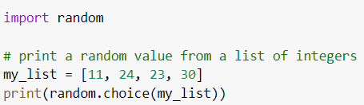
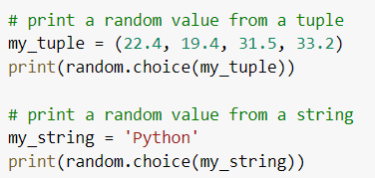

Random Library Examples

Slide 5
Demo
Demo

